Slide 1
Student Activity Fee
COVID-19 Impacts | FY21 Budget | Fee Outlook
Josh Eastwood | SGA’s Joint Vice President of Finance

Slide 2
Overview: Student Activity Fee (SAF)
Allocation
SGA allocates the Student Activity Fee (SAF) to departments and student organizations
Student Center Programs Council, Student Publications, DramaTech, and over 160 more student organizations funded
Funding traditions, building communities, and cultivating inquiry beyond the classroom
Allocated by a committee entirely of students - Graduates and Undergraduates
80 to 90 individual budgets per fiscal year, around 300+ rolling funding requests per fiscal year
Massive Policy Shift
Now under the Institute’s Registered Student Organization Policy
Changes procedure and evaluation criteria
Stagnant
Has not changed for over 10 years
Regardless of increase in requests and inflation
SAF Impacts and Outlook | 01

Slide 3
FY20 Budget Impacts
$306,144 reduction to FY20 budgets in Spring Refunds
Shutdown event spending and travel funding for all organizations
Able to delay some impacts through circumstance:
All students leaving campus
RSO operations halting
SAF Impacts and Outlook | 02

Slide 4
FY21 Budget Changes
COVID
Reduction of $279,941 due to lack of summer fee collection
Total budgetary impact of $586,085
CARES Act replaced $306,075 of prior year funds
Still working through an overall ~12% budget reduction
Policy
RSO Policy fundamentally changed evaluation criteria
Placed at Institute level, no longer directly managed by SGA
Not as malleable to immediate issues - extended update process
Reduction of limiting factors to sustain fee’s health at current level
SAF Impacts and Outlook | 03

Slide 5
Current COVID Expenses
Less than $10,000 put toward PPE
Exceedingly reliant on the Jacket-Protect-Jackets campaign
Increase in virtual event space costs - Gatherly, virtual events overall
No long-term purchases made for COVID
SAF Impacts and Outlook | 04

Slide 6
Revenue Sensitivity
Strong
Deficit
Strong Surplus
SAF Impacts and Outlook | 05

Slide 7
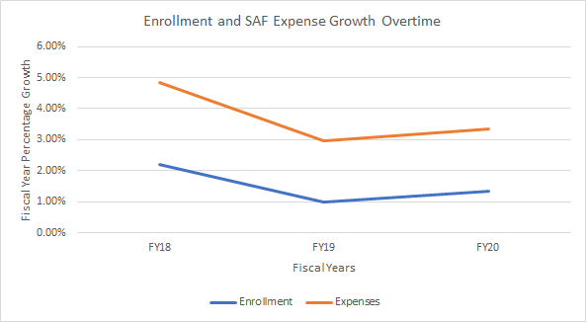
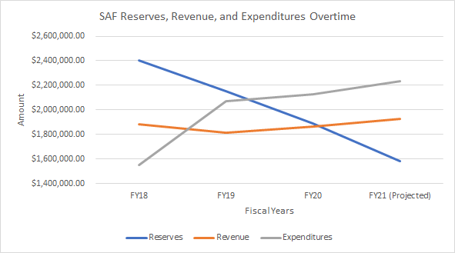
Enrollment Sensitivity
SAF Impacts and Outlook | 06

Slide 8
100% of revenue comes from SAF
Will be requesting a $10 per semester increase
Funding traditions, building communities, and cultivating inquiry beyond the classroom
SAF Impacts and Outlook | 07

Slide 9
Questions?
jeastwood3@gatech.edu

