Slide 1
Mandatory Student Fee Advisory Committee
Stamps health Services
Health initiatives
CARE

Slide 2
Mandatory Student Health Fee
Mandatory for all students registered for 4 or more credit hours
Main source of revenue for Stamps Health Services
Also provides part of the funding for Health Initiatives and CARE
Stamps Health Services does not receive funding from the Institute
Student Health Fee
Revenue from clinical activities of Stamps
Health Initiatives and CARE receive both Health Fee dollars and Resident Instruction dollars
Financial data presented today are only Health Fee related dollars and include the Health Fee dollars going to Health Initiatives and CARE.

Slide 3
Core Services/Covered by Health Fee at SHS
Unlimited visits to physicians, nurse practitioners, physician assistants and nurses in Primary Care and Women’s Health
Three hours of psychiatric care every calendar year
$25 annual contribution towards eye care ($35,000 maximum)
Flu shots
X-ray/interpretation by a board certified radiologist
Some lab tests
Pregnancy testing
STD testing (gonorrhea and chlamydia)
Blood pressure screening
Nurse Advise Line
Testing for Covid-19
Primary Care
Women’s Health
Psychiatry
Travel/Immunization/Allergy
Sports Medicine
Laboratory & Radiology
Pharmacy

Slide 4
Health Initiatives and CARE
Health Initiatives
Health Fee provides salary dollars, benefits and travel for the following:
Director of Health Promotion
2 Health Educators
2 Nutritionists
Health Fee also covers other business related expenses for Health Initiatives
CARE
Health Fee provides salary dollars, benefits, and travel for the following:
2 Case Managers

Slide 5
PROMOTING HEALTH & WELL-BEING
Health initiatives

Slide 6
Who we are
VISION: To transform the Yellow Jacket community by inspiring a thriving and resilient culture of health and well-being.
MISSION: To cultivate a thriving environment that enhances lifelong well-being among students and employees who live, learn, and work in the Georgia Tech community.
LOCATION: Joseph B. Whitehead Building (Stamps) 2nd floor
SUB-UNITS: Community Nutrition, Health Education, VOICE

Slide 7
Community nutrition
Health Initiatives has two registered dietitians on staff to help you have healthful and balanced eating habits, on and off campus. We encourage you to eat a balanced variety of foods that satisfy both your body and mind.

Slide 8
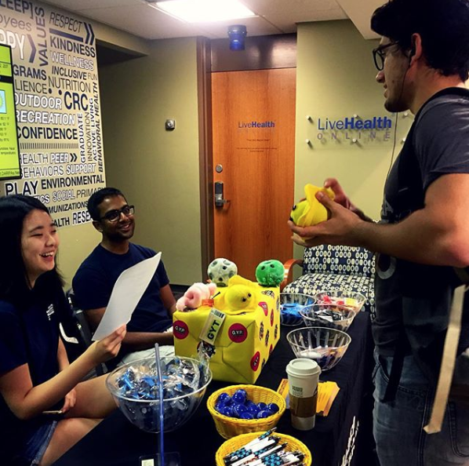
HEALTH EDUCATION
Education, outreach, and awareness events for the campus related to:
Alcohol
Sexual Health
Stress and Anxiety
Time Management
Sleep
Mindfulness
Resilience, etc.

Slide 9
VOICE
Sexual and Relationship violence prevention and response initiative
Founded on the premise that everyone has the right to live and learn at Georgia Tech, free of violence or the threat of violence
2 VOICE advocates
1 Health Educator

Slide 11
Center for Assessment, Referral and Education (CARE)

Slide 12
CARE
Center for Assessment, Referral and Education (CARE) offers students:​
Single point of entry for mental health services on and off campus
Mental health assessments​
Case management and follow-up services
CARE Plan
Rapid access to appropriate campus and community resources
Location
Smithgall Student Services (Flag) Building
Located in Suite 102B
Phone: 404-894-3498
www.care.gatech.edu
Hours are Monday – Friday 8:00 a.m. – 5:00 p.m., Tuesday 9:00 a.m. – 5:00 p.m.
Services in CARE are confidential and at no additional charge
All degree-seeking enrolled students are eligible
All students are given an electronic CARE Plan
​
​

Slide 13
CARE operations since Covid-19
CARE has been providing services through telebehavioral health since the Covid-19 pandemic resulted in a shift to remote service provision.
CARE staff contacted all clients served in Spring/Summer 2020 for case management follow up due to Covid-19 impacts
Students call CARE at 404-894-3498 to schedule an appointment and complete paperwork online.
Most appointments are provided via Blue Jeans or telephone
Hours are Monday, Wednesday, Thursday and Friday 8:00 a.m. – 5:00 p.m., Tuesday 9:00 a.m. – 5:00 p.m.
Students who need services from the Counseling Center or Stamps Psychiatry need to start in CARE.
​

Slide 14
CARE: Year 1 in Review
Total number of new assessments in CARE since August 2019: 1,881
Total contacts in CARE since August 2019: 4,946
CARE opened using a walk-in model exclusively but expanded to offer appointments based upon student need.
On average, all students received the next available appointment (counseling, psychiatry) the same day as their assessment or within one (1) business day.
CARE administered client satisfaction surveys for the 2019-20 academic year
​

Slide 15
CARE: Year 1 in Review
Satisfaction Survey Highlights:
Overall, how satisfied were you with the services you have received at CARE?
98% Satisfied or Extremely Satisfied
How satisfied were you with your CARE Assessment and the referrals provided?
94% Satisfied or Extremely Satisfied
How satisfied were you with the clinician who conducted your CARE assessment?
98%Satisfied or Extremely Satisfied
​

Slide 16
CARE: Year 1 in Review
​

Slide 17
CARE: Year 1 in Review
​
Top 10 Referrals: | Percent:
Off-Campus Counseling Services | 25.3
Informal Recreation | 17.65
On-Campus Counseling Services | 16.08
Lifeskills Workshops | 12.65
C2D2 Services | 9.21
On-Campus Psychiatric Treatment | 6.98
Academic Coaching | 5.9
Campus Emergency Services | 5.6
Health Initiatives Wellness Coaching | 5.24
Nutritionist | 5.06

Slide 18
Stamps Health Services Patient Visits

Slide 19
Patient Visits

Slide 20
How do students feel about Stamps?

Slide 21
Revenue Impact due to covid

Slide 22
Unplanned expenses due to covid

Slide 23
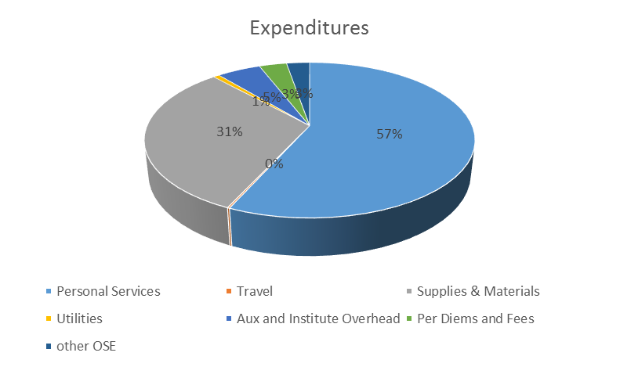
FY20 Budget and actuals
 | FY20 Budget | FY20 Actuals
Revenue
Mandatory Fee Revenue | $7,920,041 | $7,573,489
Clinic & Pharmacy | $3,852,168 | $4,126,062
Psychiatry Clinic | $37,629 | $25,444
Dental Space Lease | $49,078 | $35,667
Miscellaneous Revenues | $0 | $85,797
Interest | $225,147 | $131,585
Total Revenue | $12,084,063 | $11,978,044
Expenditures
Personal Services | $7,537,065 | $6,601,350
Travel | $37,824 | $21,471
Supplies and Materials | $2,871,169 | $3,654,070
Utilities | $113,149 | $82,973
Aux and Institute Overhead | $832,010 | $594,584
Per Diems and Fees | $383,153 | $372,869
Other OSE | $489,240 | $313,912
Total Expenses | $12,263,610 | $11,641,229

Slide 24
FY20 Budget and Actuals -Summary
 | FY2020 Budget | FY2020 Actuals
Total Revenue | $12,084,063 | $11,978,044
Total Expenditures | $12,263,610 | $11,641,229
Surplus/(Deficit) | ($179,547) | $336,815

Slide 25
Historical Trends

Slide 26
Budget FY21 and FY22
 | FY21 Budget | FY 2022 Budget
REVENUE
Mandatory Fee Revenue | 7,953,270 | 7,927,883
Clinic & Pharmacy | 4,587,934 | 4,289,082
Psychiatry Clinic | 38,006 | 52,031
Dental Space Lease | 47,050 | 48,612
Miscellaneous Revenues | 0 | 25,000
Interest | 62,272 | 134,217
Total Revenue | 12,688,532 | 12,476,825
EXPENDITURES
Personal Services | $7,584,081 | $7,734,023
Travel | $29,935 | $29,935
Supplies & Materials | $3,032,442 | $3,799,673
Utilities | $113,149 | $87,121
Aux and Institute Overhead | $872,968 | $620,199
Per Diems and Fees | $442,000 | $380,326
other OSE | $526,603 | $371,134
Total Expenditures | $12,601,178 | $13,022,411
Notes:
Personal Services:
Total $7,734,023
Stamps $7,179,222 (67 positions + temp/prn positions)
HI $423,196 (5 positions)
CARE $131,605 (2 positions)

Slide 27
Financial Challenges and Uncertainties
Covid 19
Revenue reductions and increased expenses impact cash flow
Continued uncertainty re: impact makes planning difficult
Changes to the Student Health Insurance Plan (SHIP)
So far the new SHIP vendor has not adversely affected Stamps’ financial picture
Keeping salaries at Stamps competitive with the market
Staff turnover necessitates that we be competitive in the marketplace in order to hire quality people
Persistent pressure to limit fee increases. Historically the Health Fee has only been increased to add a service. The fee has not increased to cover increased costs of maintaining services (merit raises, increases in expenses due to inflation, etc.)
Limited areas in which to cut expenses in a significant way except in staffing

Slide 28
GT Health Fee

Slide 29
Fee Request for FY22
At this time Stamps is not planning to ask for a fee increase for FY22
Stamps has reserves sufficient to meet our goal of 3 months operating cash on hand and additional funding for facility renovations and equipment replacement.
We are anticipating personnel expenses in FY21 being less than budgeted due to vacant positions
We are anticipating there will not be a significant change in need for services from Stamps in the 21-22 academic year, so anticipate clinical revenue will be relatively steady.
We may need to consider a Health Fee increase in FY23.

Slide 30
Health fees recommendations

