Slide 1
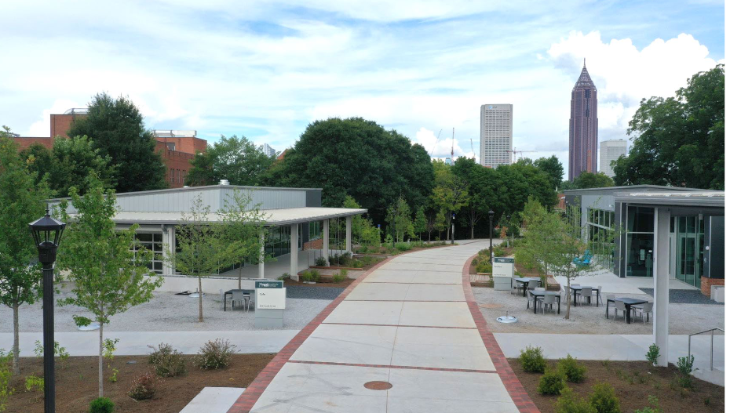
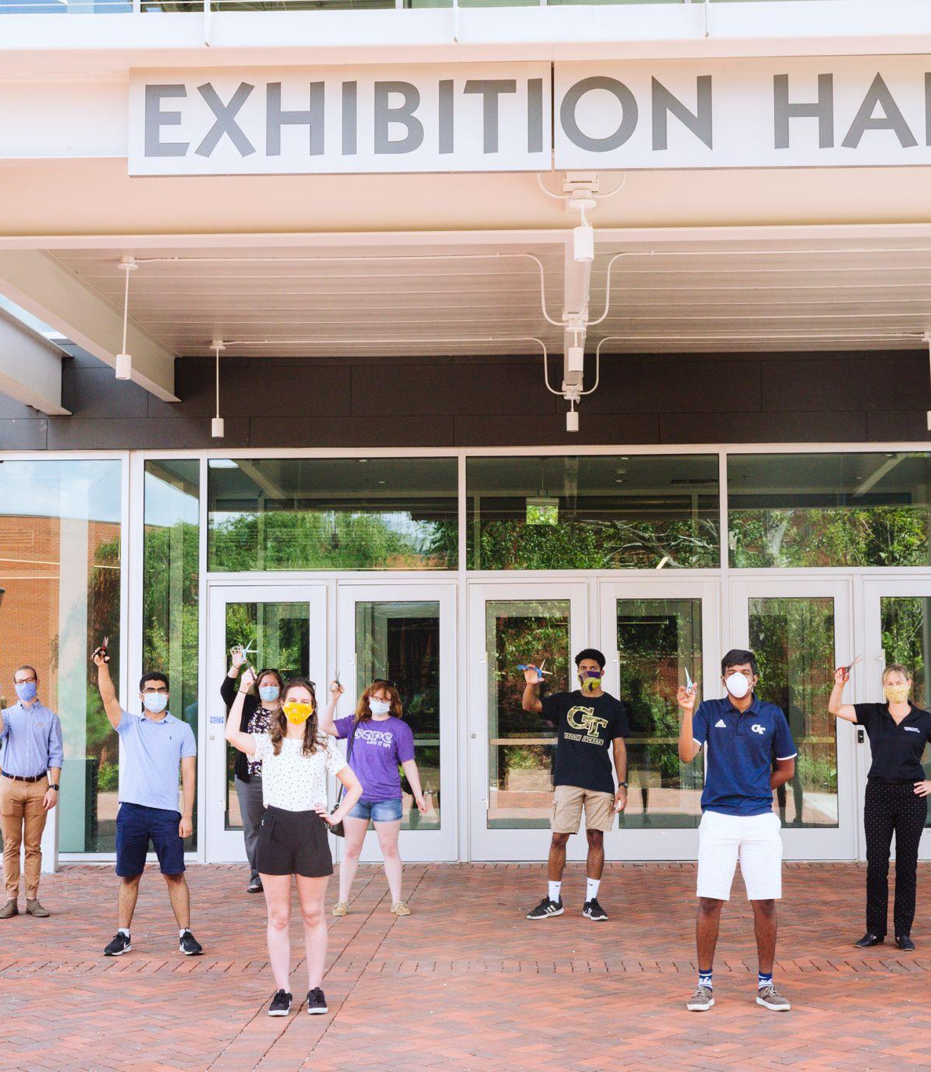
Student Center
FY21 Budget Review
Covid-19 Impact and Outlook on Fee Request

Slide 2
Student Center Budget – FY21
Funding Sources - FY21

Slide 3
Student Center Operation Fee – FY21
Personal Services
$1,395,750
18 full time staff
80 Student Employees
Non-Personal Services
$45,070
Supplies & Material
Maintenance & Repairs
Contracted Services
Telecommunications

Slide 4
Is the Student Center able to execute budgets as presented during the last cycle?
Yes, the SC can execute the budget as presented.
The SC team did not stop working during the Pandemic and campus was closed.
75% of the staff still reported to work from March until July. 100% of staff are now reporting and coming to campus each week with varied and hybrid schedules.
Examples:
The operations team moved the SC to the Pavilion, including shutting down and moving all furniture out of the student Center.
Post Office never closed and custodial team was onsite daily to clean
Student team members when safe were utilized in areas as needed including helping to pack
The programs team worked on WoW and program planning for small semester. Planned homecoming and had continued engagement with SCPC members. They had a virtual retreat in August, recruitment and a new member virtual retreat. The also packed up P&C, Tech Rec and UtC

Slide 5
SIX FEET SOCIAL DISTANCE CAPACITIES
Exhibition Hall Meeting Rooms
 | Normal Capacity Lecture Pre-COVID | LECTURE | BANQUET ROUNDS | CLASSROOM | BOARDROOM | OPEN U | CLOSED U
MIDTOWN II | 408 | 46 | 48 | 28 | 13 | 12 | 15
MIDTOWN V | 112 | 25 | 18 | 10 | 7 | 6 | 8
BUCKHEAD | 60 | 6 | N/A | 4 | 3 | 4 | 5
HOME PARK | 70 | 12 | N/A | 6 | 5 | 6 | 8
CENTENNIAL | 63 | 12 | N/A | 6 | 5 | 7 | 7
LITTLE FIVE POINTS | 20 | N/A | N/A | N/A | 2 | N/A | 2
INMAN PARK | 30 | 4 | N/A | 4 | 3 | 3 | 4
CABBAGETOWN BOARDROOM | 20 | N/A | N/A | N/A | 9 | N/A | N/A
West Village Meeting Rooms
 | LECTURE | CLASSROOM | BOARDROOM | OPEN U | CLOSED U
ENSEMBLE | 20 | 12 | 5 | 8 | 10
UNPLUGGED | 12 | 8 | 8 | 5 | 6
CLASSROOM 163 | 16 | 9 | N/A | 6 | 8
CLASSROOM 175 | 24 | 12 | N/A | 7 | 8
CLASSROOM 275 | 12 | 9 | 4 | 7 | 8
CLASSROOM 277 | 12 | 9 | 4 | 7 | 8
Please note that these capacities vary based on special requests, including staging and other equipment. Our Event Services Team is happy to discuss setups other than what is described here.
STUDENTCENTER.GATECH.EDU

Slide 6
Questions related to COVID
To which degree have budgets presented for FY21 fees been enforced? And which elements were not enforced?
All elements of the budget have been enforced.
Was budgeted money reallocated to COVID expenses? And if not all of it, what happened to funds that were budgeted but couldn’t be spent?
We did not reallocate our current fee dollars for COVID expenses. We were able to use RI monies for COVID related purchases
At year end we returned $2K back to SGA from the Tier II programming budget

Slide 7
Questions related to COVID
How does an unexpected increase in student enrollment constrain our department? What’s the sensitivity of units towards student numbers?
We are already constrained on space due to the Campus Center project and being in temporary spaces.
The size of the Campus Center was based on average increases provided by the institute at the time of planning
If Georgia Tech increases enrollment and deviates greatly from the average 1% increase, we will have outgrown the new buildings and space before we move into it.
What other sources of revenue do the units have?
Our main source of revenue is renting space to the community and use of AV. Currently we are seeing a significant decrease in events and revenue.
Pre-COVID the Student Center on average earns $400K in revenue each year.
Due to construction revenue was already reduced for FY21 and has been reduced even more dramatically due to COVID.
We are anticipating about 75K in revenue for FY21.

Slide 8
Questions related to COVID
Related to COVID spending, what were one-time costs that needed to shoulder? What are costs that will occur if the situation continues?
We had to purchase fogger machines to clean the buildings and increase the cleaning supplies for all areas.
Supplies were purchased through year end RI funds - not activity fee monies.
What permanent changes have been made in the unit due to COVID events? What are temporary changes that would be rolled back?
At this time we have not had to roll back services, except during the 2 hours from 2 – 4 when we are cleaning and are not having events.
We have decreased capacities in our spaces. We will change back to normal when applicable.
If a staff member vacant a positions, it will be challenging to fill the position due to the Critical Hire process. This could change services down the road.

Slide 9
Campus Center Facility Fee FY22
There will be no increase to the $85 Facility Fee that goes toward the debt for FY22

Slide 10
Student Center Operations Fee FY22
For FY22 we are requesting a fee increase to the Student Center Operations fee.
Increase would start Jan 2022
$25 increase to cover the cost of staff, maintenance and operations of a building that will increase the square footage by 65,000 and now encompass 5 buildings.
For example: staff is needed for the increased square footage and new student specific areas (Multicultural space, Graduate Student Space, Reflection Space)
Fee increase was calculated based on current price per square foot.
*Specific details to come in the FY22 fee presentation*

Slide 11
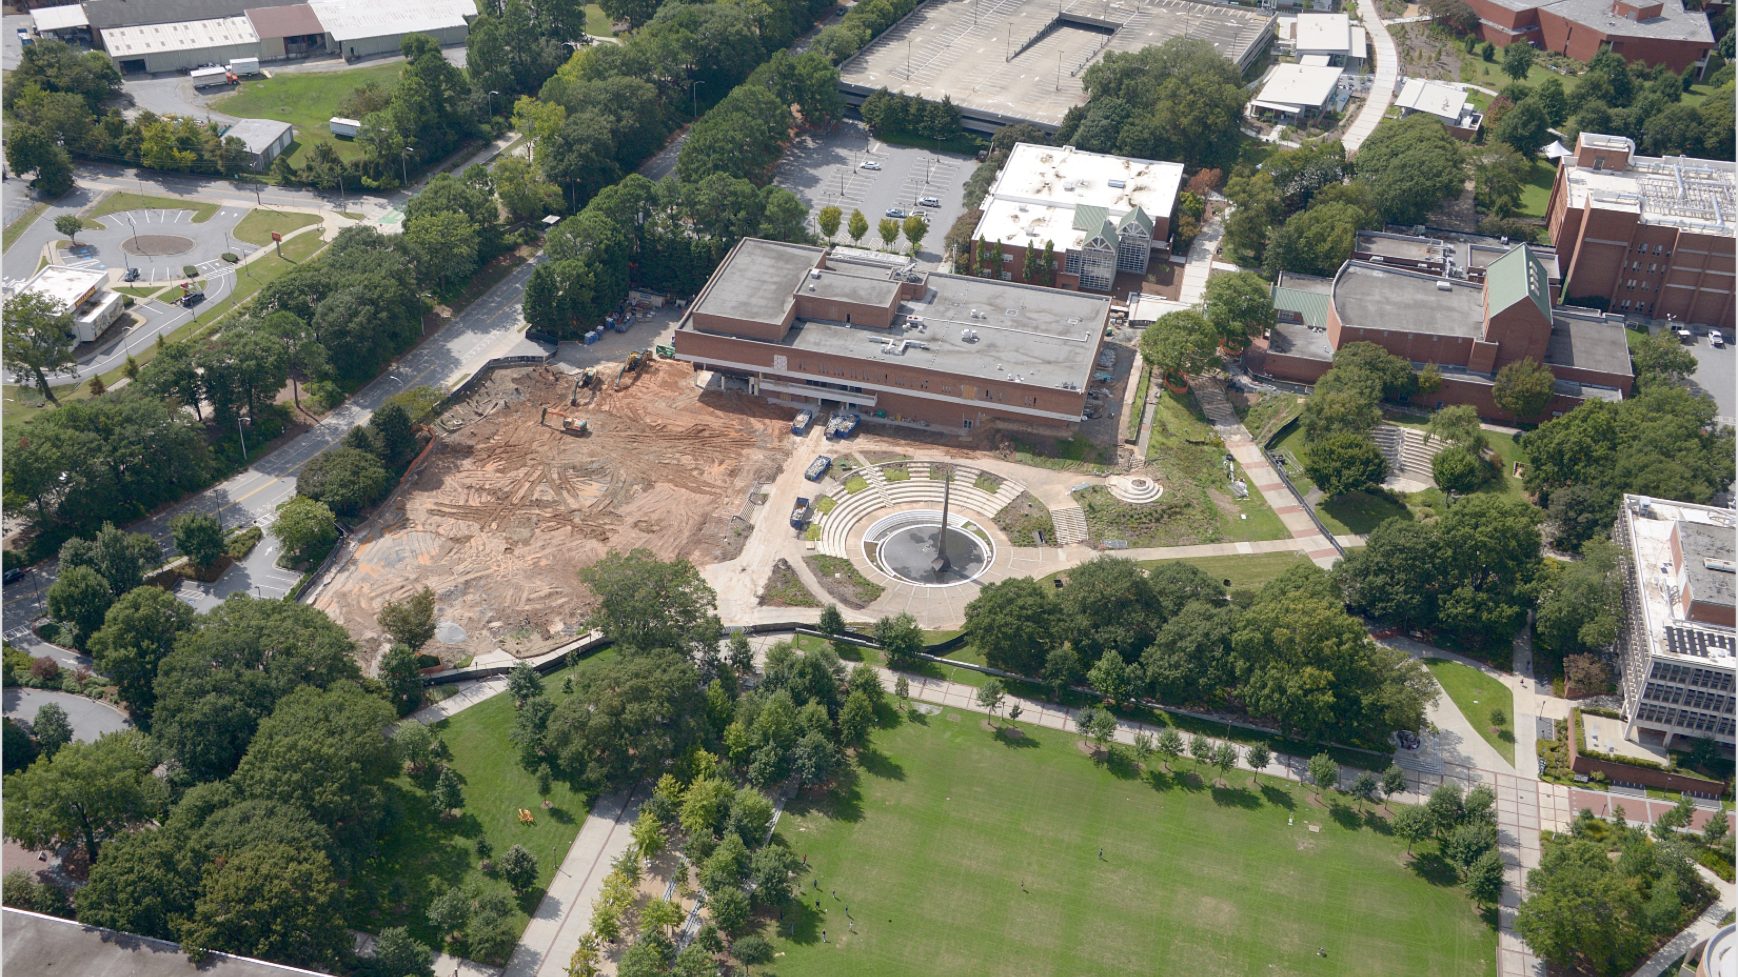
Questions?

