Slide 1
GEORGIA TECH ATHLETIC ASSOCIATION MSFAC FINANCIAL UPDATE OCTOBER 8, 2020

Slide 2
FUND BALANCE SUMMARY

Slide 3
FY21 OPERATING BUDGET
Approved operating budget – June 2020
Full football season with attendance at 50%
Generated revenue reduction of $7MM
Revised operating budget – October 2020
Amended football schedule with 20% attendance
Additional generated revenue reduction of $8MM
Enhanced testing and other health/safety initiatives

Slide 4
FY21 OPERATING BUDGET
Enhanced fundraising support - $6MM
Candler Fund, AD Initiative, Support the Swarm, etc.
Significant cost containment - $11MM
Workforce management strategies
Operating budget cuts up to 40% per unit/sport
Scholarship and meal plan reductions
Scheduling adjustments to reduce costs (e.g. Notre Dame)

Slide 5
FY21 OPERATING BUDGET
 | FY20 OPERATING RESULTS (ACTUALS) | FY21 OPERATING BUDGET (FINAL) | VARIANCE | %
Revenues | $81,301,974 | $75,332,000 | ($5,969,974) | -7%
Expenses | $91,003,660 | $75,332,000 | ($15,671,660) | -17%
Net Surplus/(Deficit) | ($9,701,686) | $0 | ($9,701,686)
Beginning Fund Balance | ($3,877,395) | ($13,579,081)
Net Surplus/Deficit | ($9,701,686) | $0
Ending Fund Balance | ($13,579,081) | ($13,579,081)

Slide 6
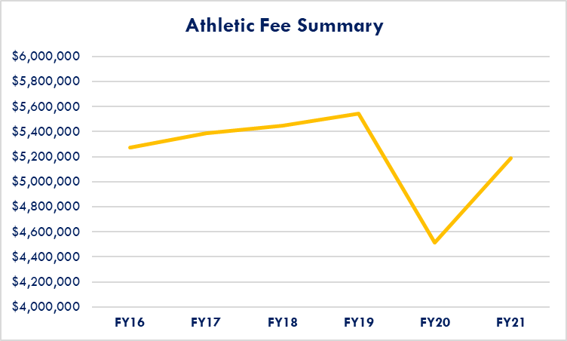
COVID IMPACT ON ATHLETIC FEES
No fee increase since 2012
FY20 - prorated reduction for spring semester
FY21 – minimal impact with strong enrollment

Slide 7
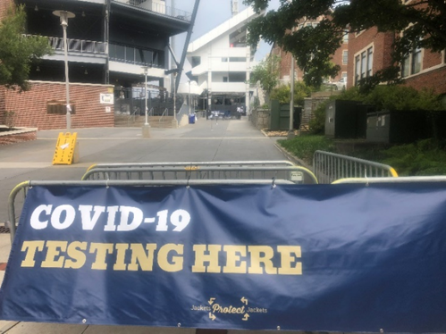
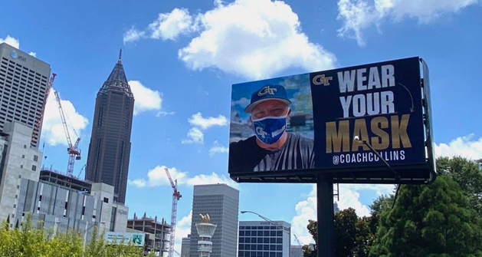
STUDENT INITIATIVES
Commitment to student health and safety
Testing locations – BDS and McCamish Pavilion
#JacketsProtectJackets campaign partner
Utilization of brand and overall influence to enhance internal and external messaging

Slide 8
STUDENT INITIATIVES
Provide face-to-face engagement opportunities on campus
Socially distant attendance at FB games
Virtual game-day experiences
Flicks @ Tech movie series hosted at Bobby Dodd Stadium
Men’s basketball attendance – TBD?

Slide 9
THE FUTURE
The Athletic Association is committed to…
Student physical and mental health initiatives
Partnering with student organizations to build community beyond athletic events
Finding new opportunities to generate revenue
Requesting fee increases for specific student initiatives
Maintaining competitive programs that make us all proud

Slide 10
QUESTIONS

