Slide 1
Student Activity Fee
MSFAC Presentation
FY2021

Slide 2
Overall Mission
The Student Government Association’s mission is to empower student organizations, embody student opinions, preserve student integrity, and enrich the student experience

Slide 3
Purpose
Our goal is to allow students to:
Have a widespread impact on the student experience at GT
Bring new and enriching cultural experiences onto campus
Empower student activities and encourage student leadership

Slide 4
HOW DO WE ACHIEVE THIS?

Slide 5
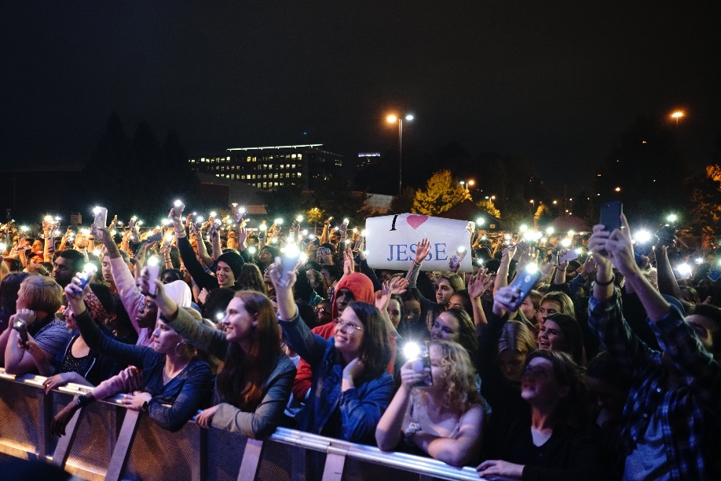
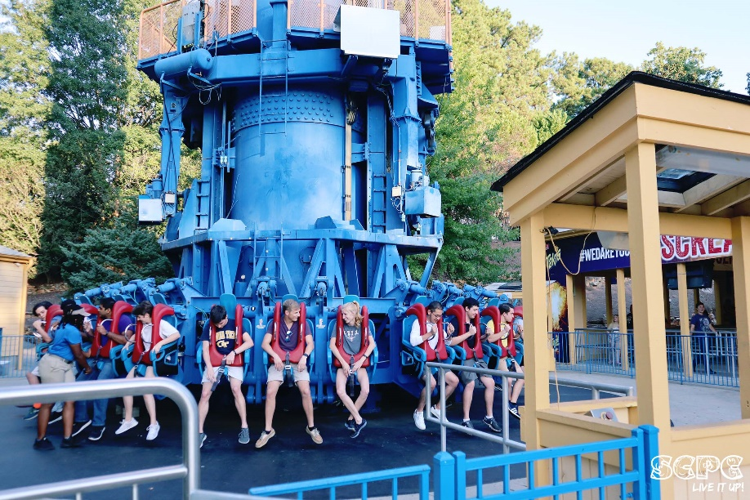
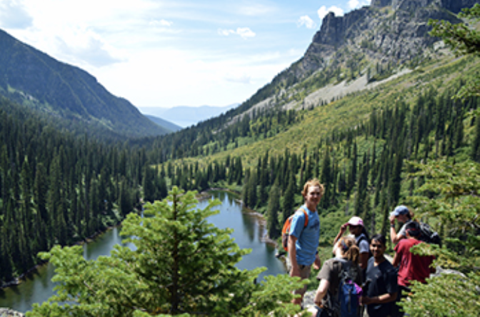
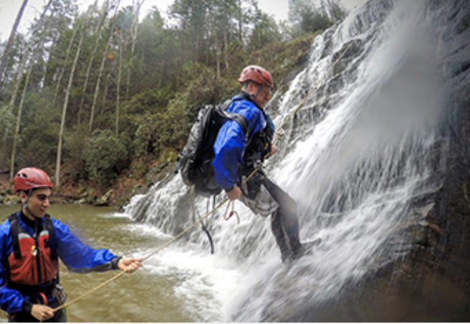
Providing Widespread Impact
SCPC
45
events
25,000+
students
Homecoming Concert
Night at Six Flags
ORGT
160+
excursions
150,000+
contact hours
Backpacking
Cascading

Slide 6
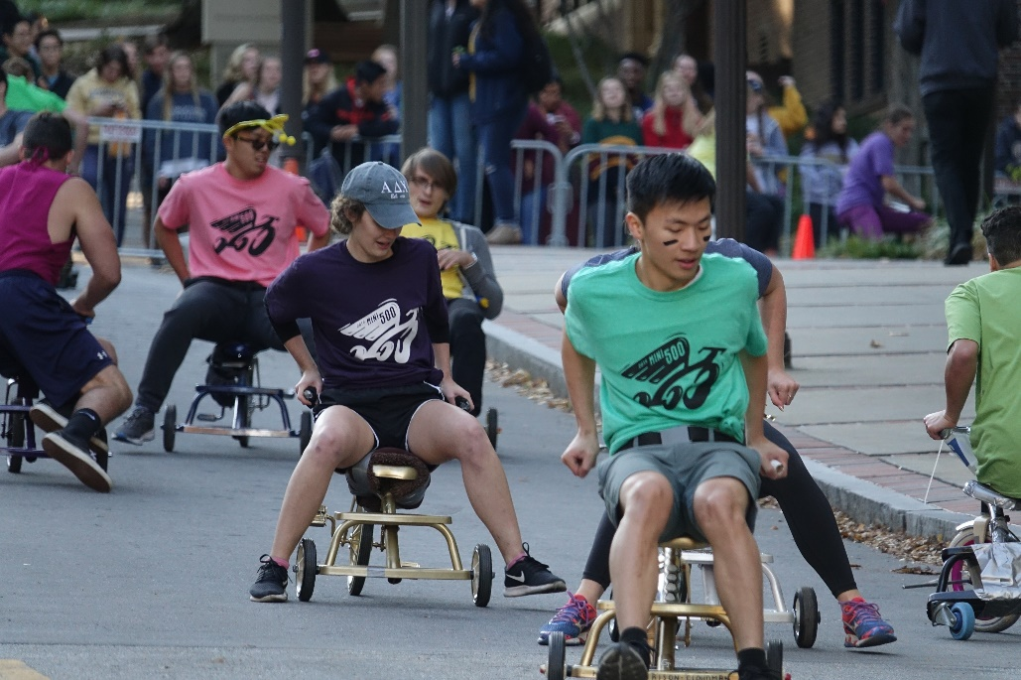
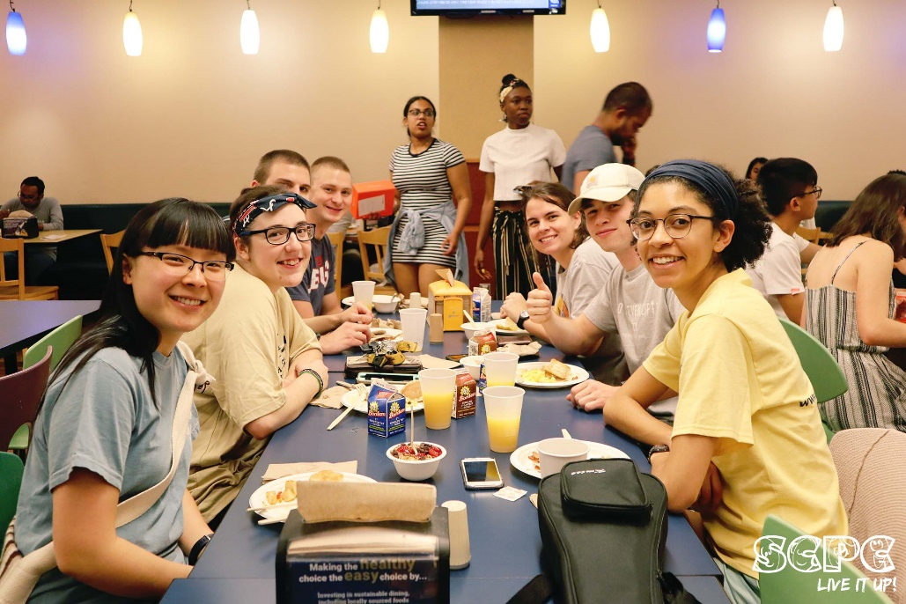
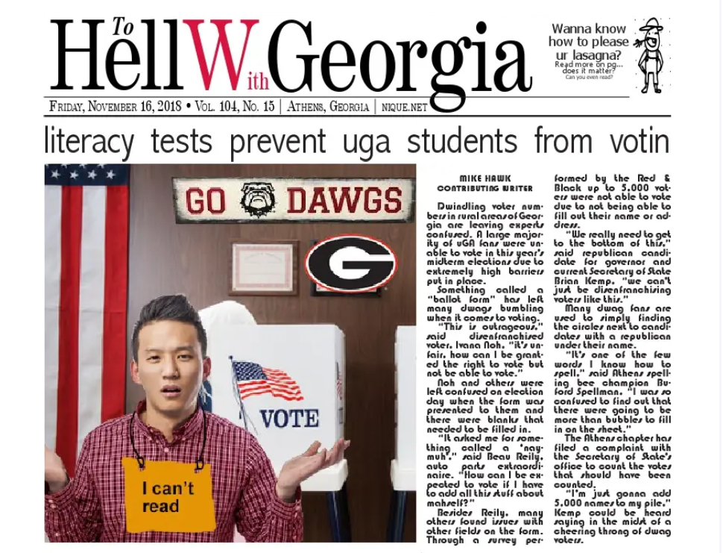
Preserving Campus Tradition
Ramblin' Reck Club, Mini 500
SCPC, Midnight Breakfast
Ramblin' Reck Club, T-Book
Student Publications, Technique

Slide 7
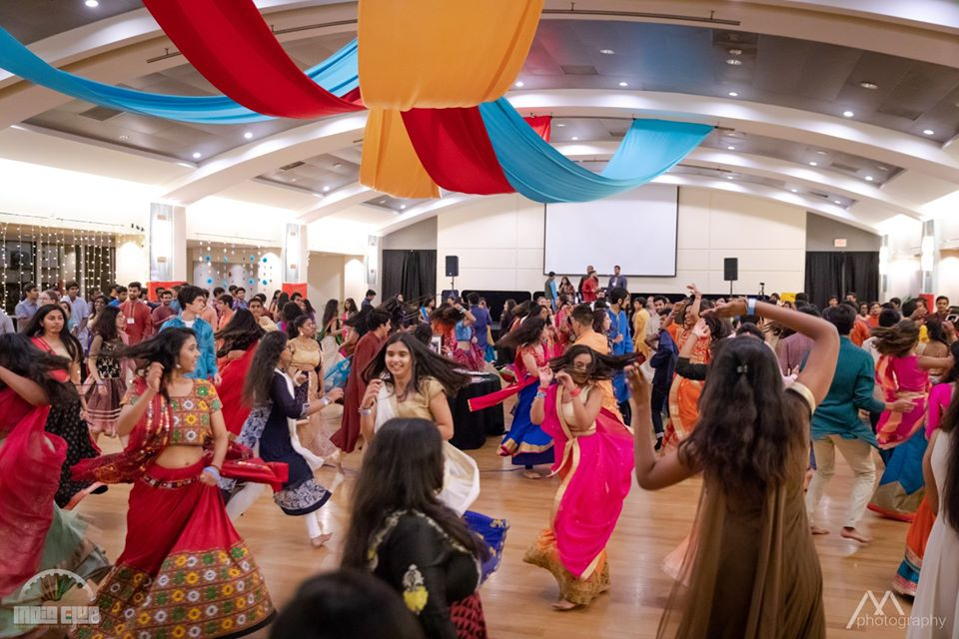
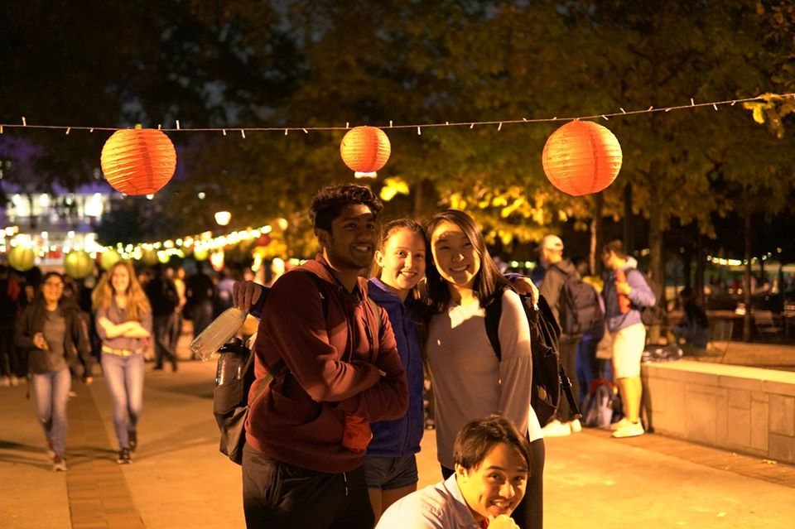
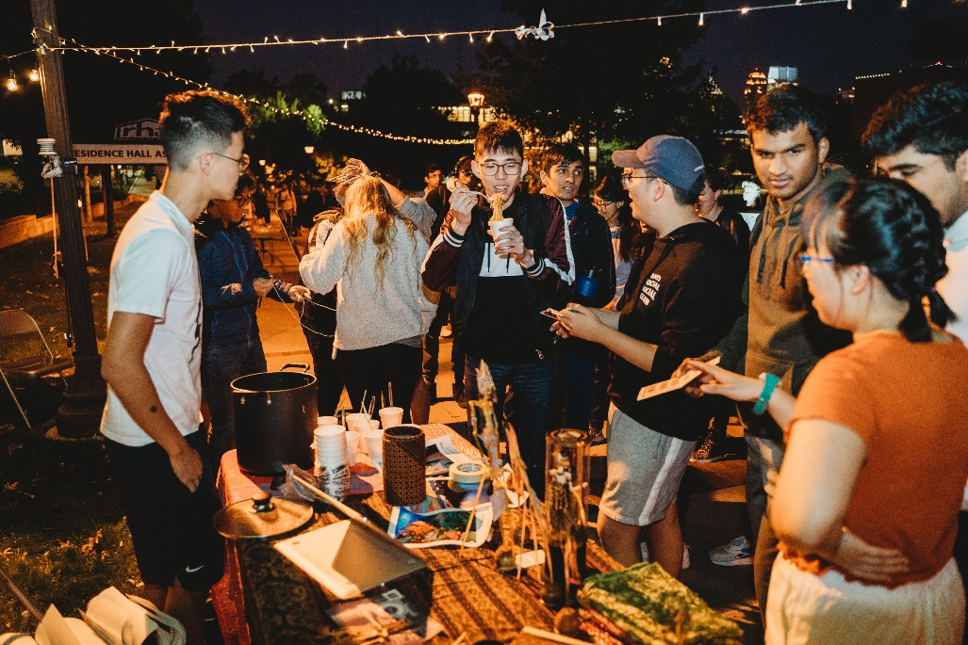
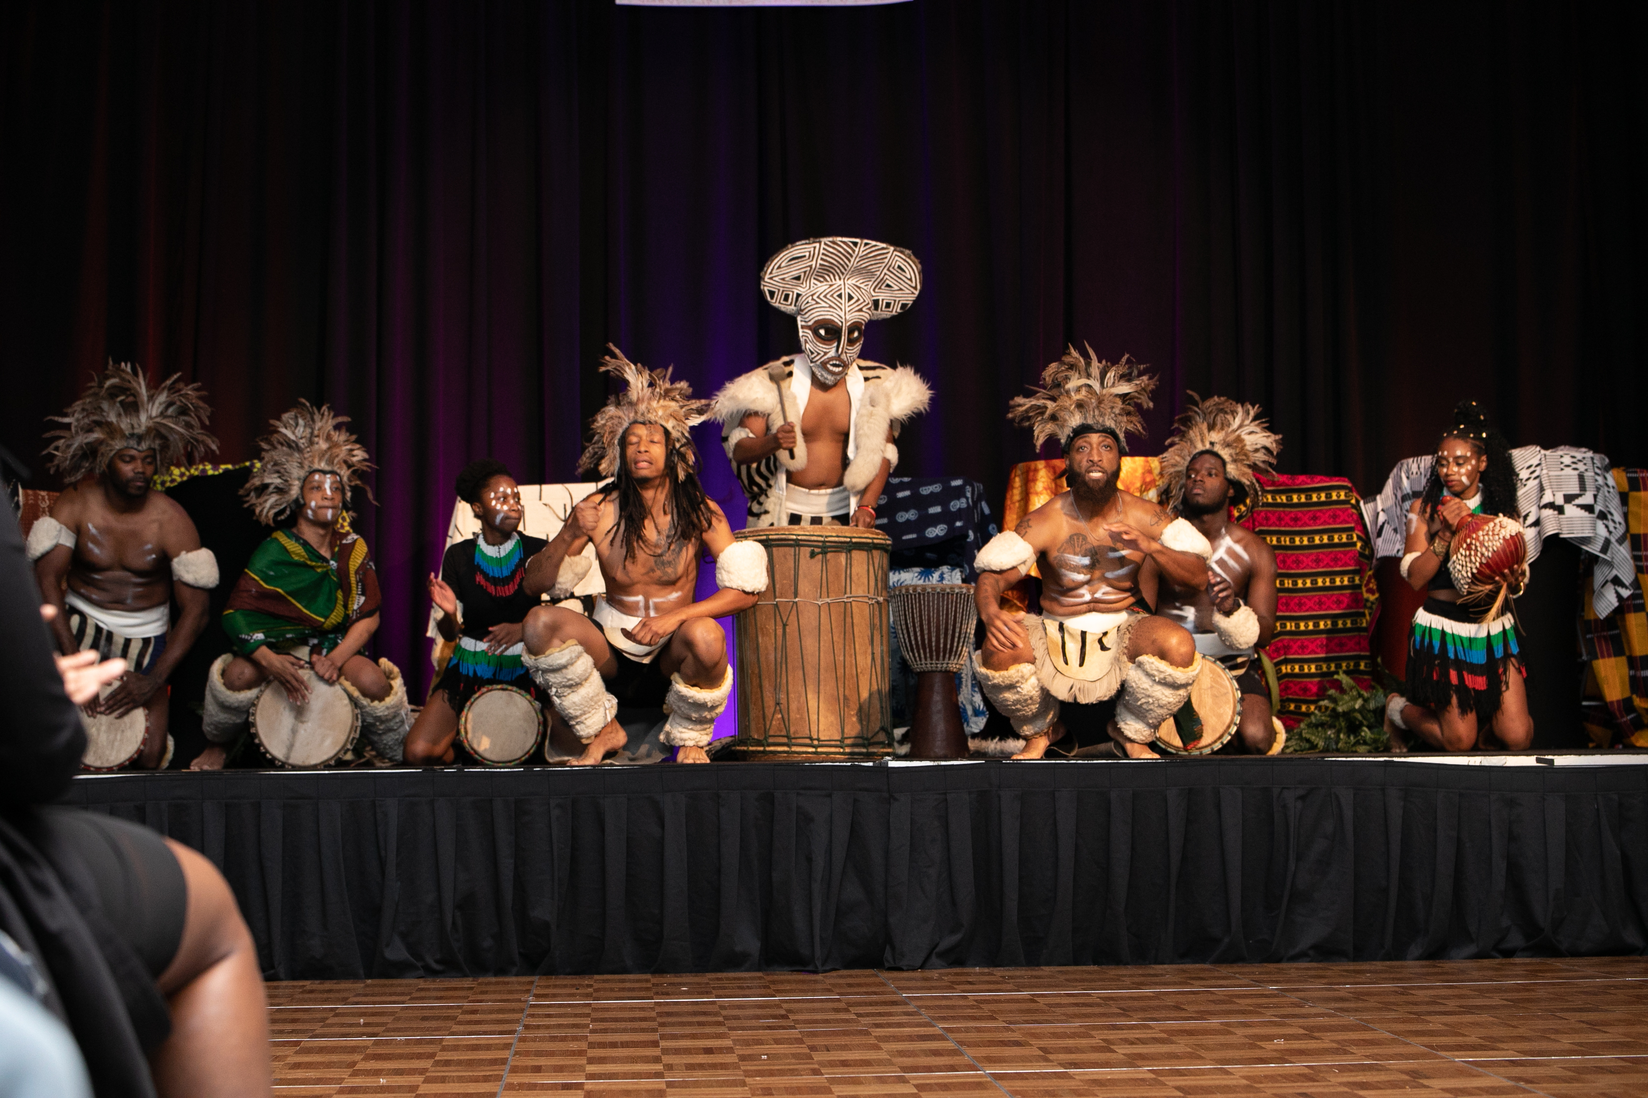
Enriching Cultural Experiences
India Club, Garba
VSA, Moon Fest
GTIA, Night Market
ASA, Taste of Africa

Slide 8
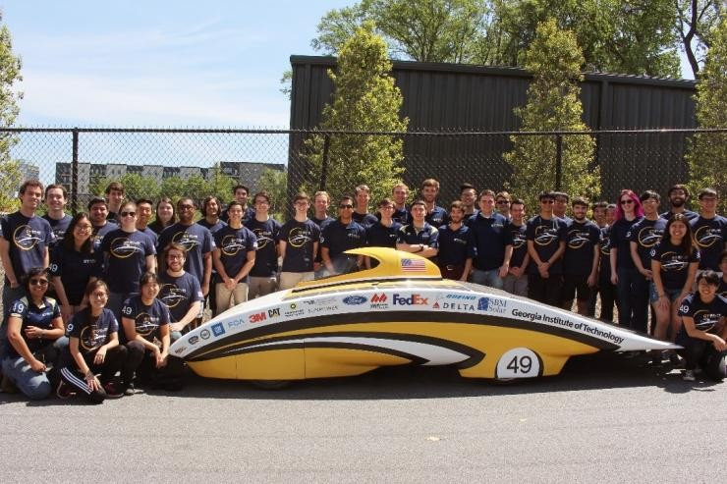
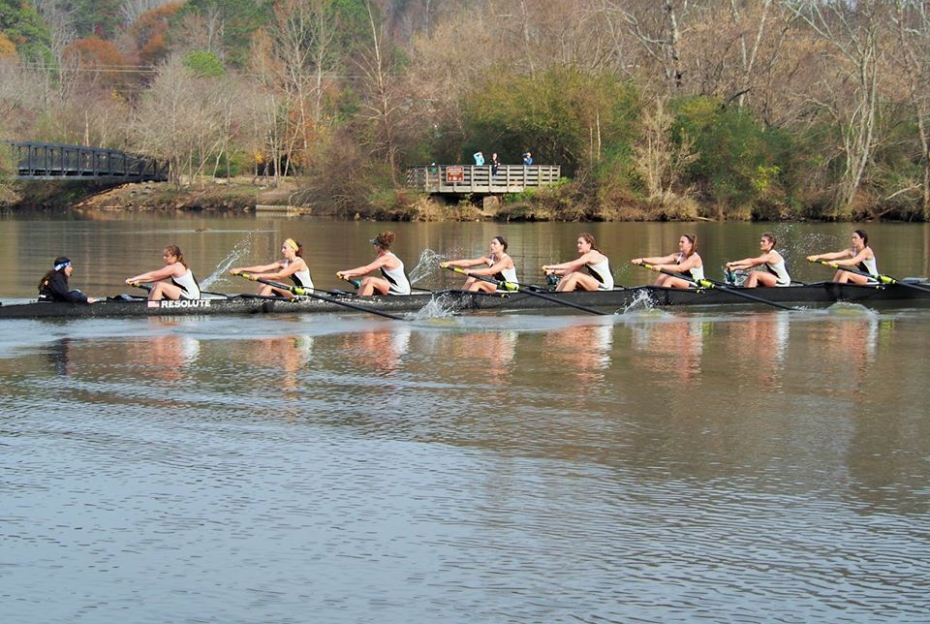
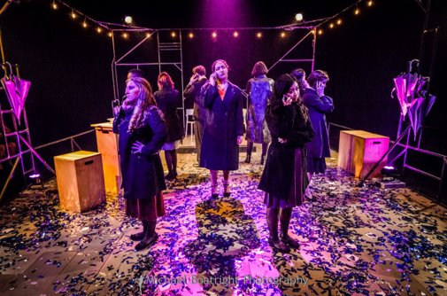
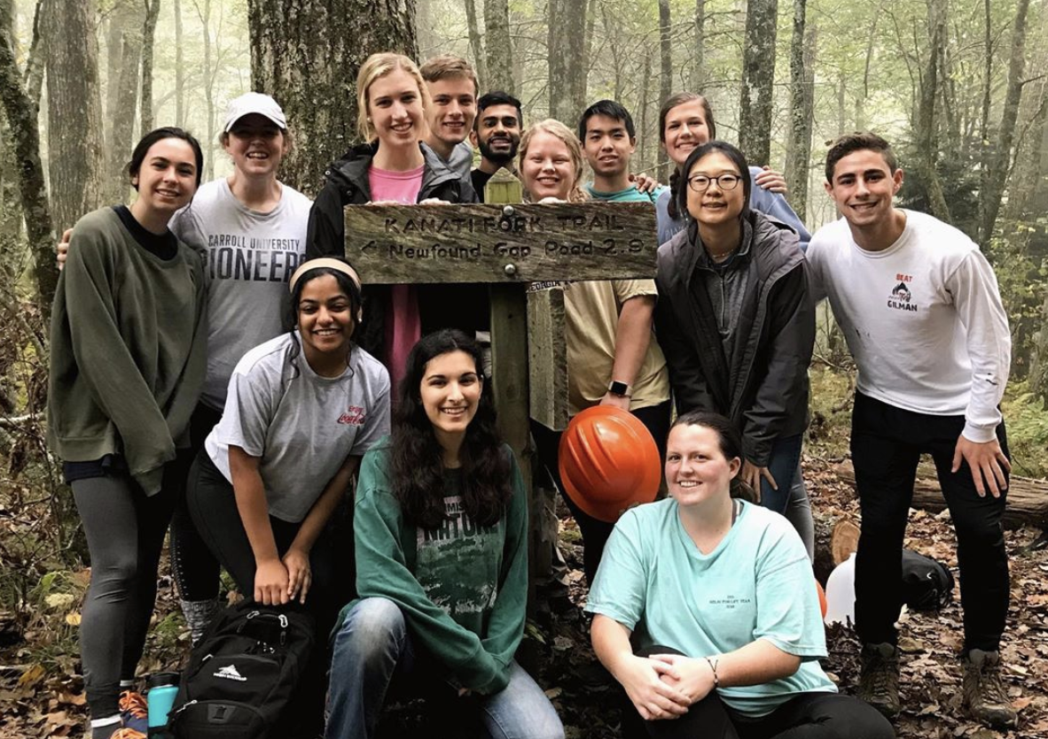
Empowering Student Activities
GT Solar Racing
GT Crew
DramaTech Theatre
Alternative Service Breaks

Slide 9
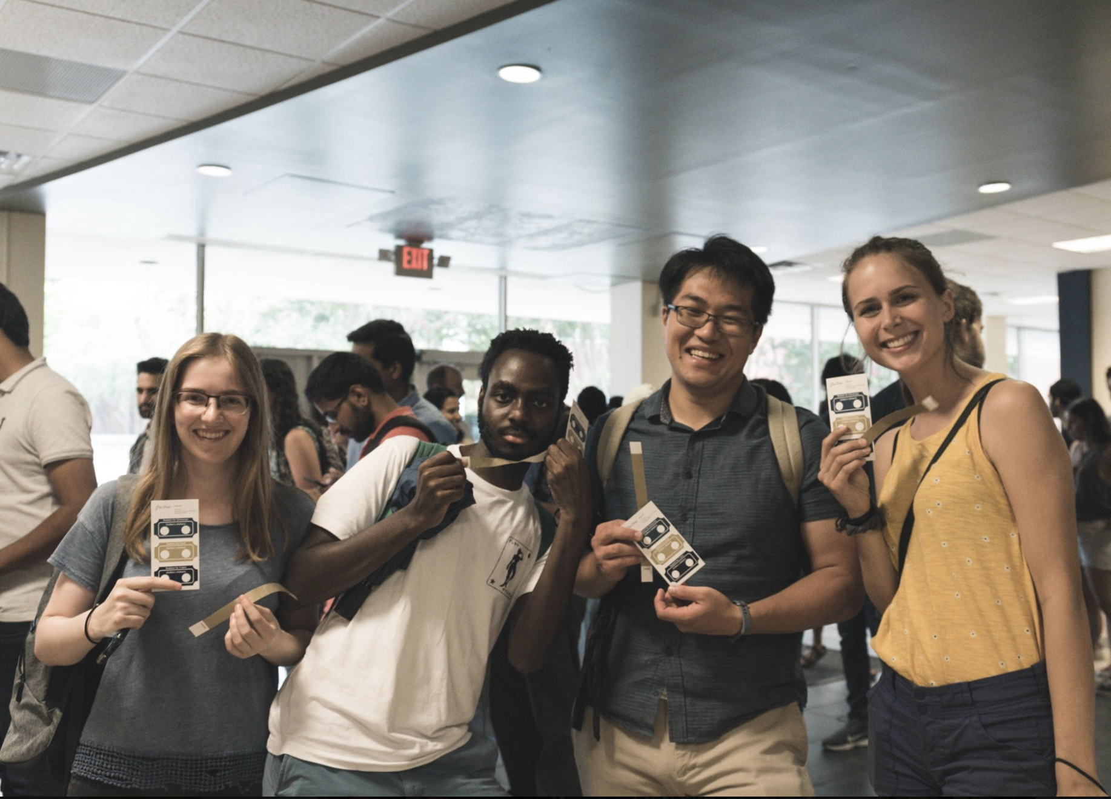
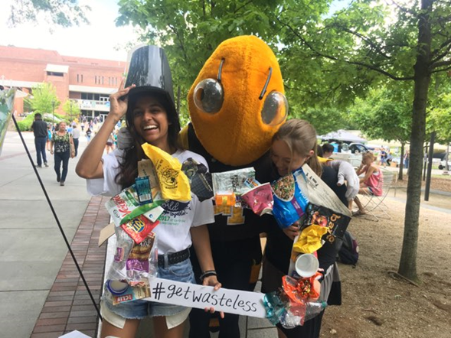
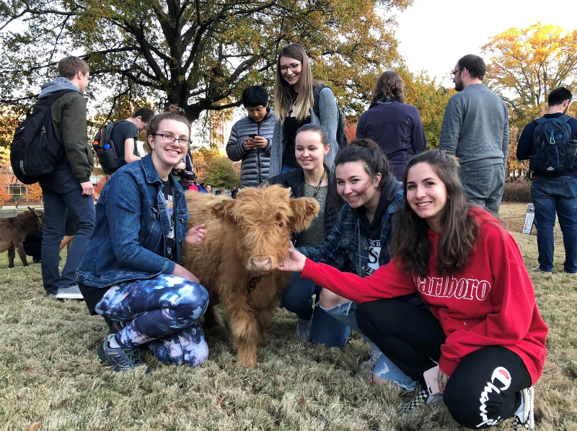
Expanding Student Government's Impact
Graduate Picnic
Get Wasteless
Up with the White and Gold
Petting Zoo

Slide 10
Allocations Process

Slide 11
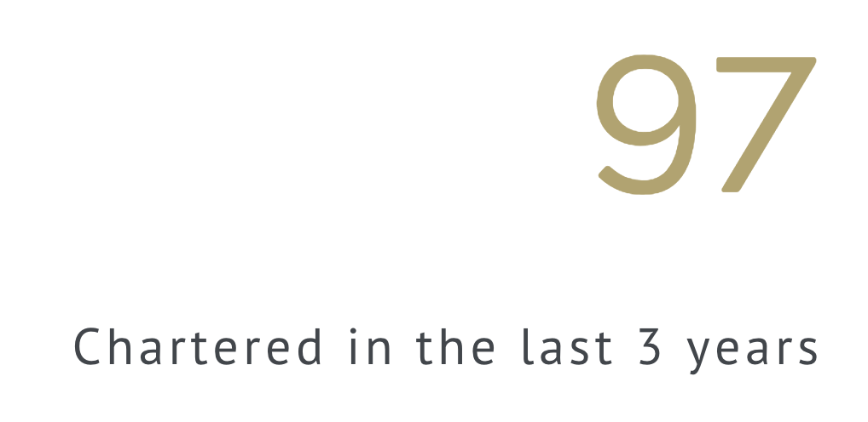
Who Can Request Funding
Notes:
FY19, 160. FY20 180+

Slide 12
Budgets (Annually)
Bills (Rolling)

Slide 13
Current Financial Situation

Slide 14
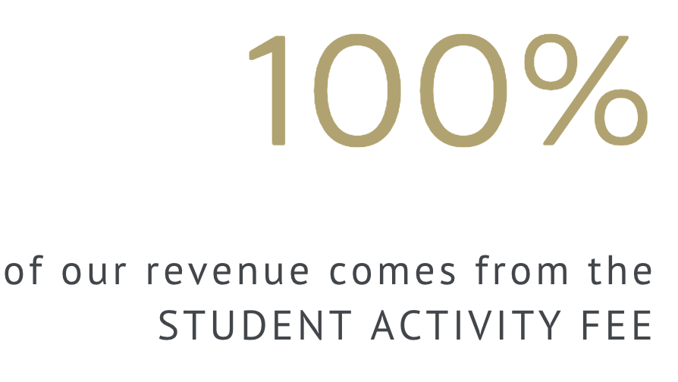

Slide 15
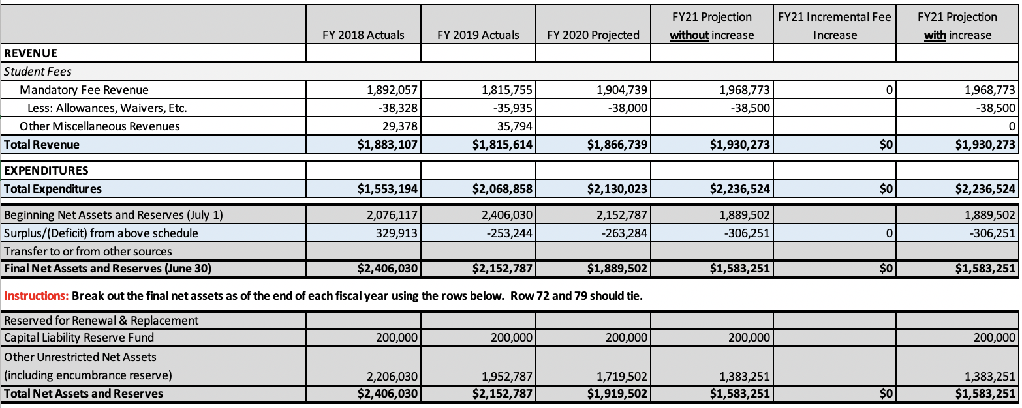
FY2019 - Actuals
($253,244) – Deficit for FY2019
This does not factor a further $137,623 in net rollovers, which are funds that are guaranteed to organizations that are not reflected in the balance sheet

Slide 16
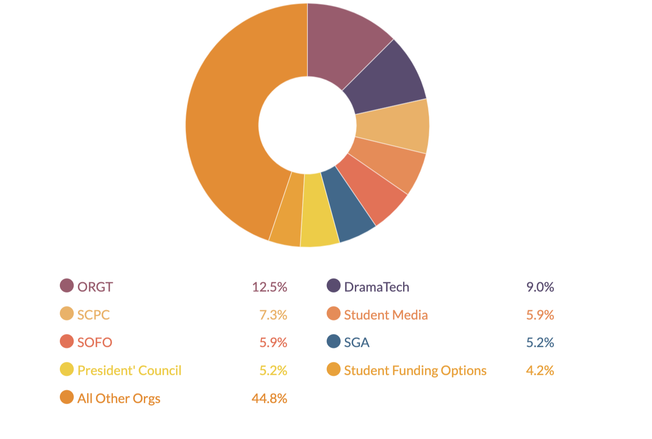
FY2019 - Allocation Breakdown

Slide 17
FY2019 Deficit
In FY2019, we spent $9.59 more than our revenue per student fee instance
Organization | Amount | Portion of SAF
Outdoor Recreation | $275,995 | $6.20
DramaTech | $198,380 | $4.46
Student Center Programs Council | $160,116 | $3.60
Student Media | $129,907 | $2.92
SOFO | $129,329 | $2.91
SGA | $115,569 | $2.60
President's Council | $114,581 | $2.58
Professional Development Funds (CDF/GCF/UCF) | $93,329 | $2.10
All Other Organizations | $989,276.12 | $22.23
Total | $2,206,481 | $49.59

Slide 18
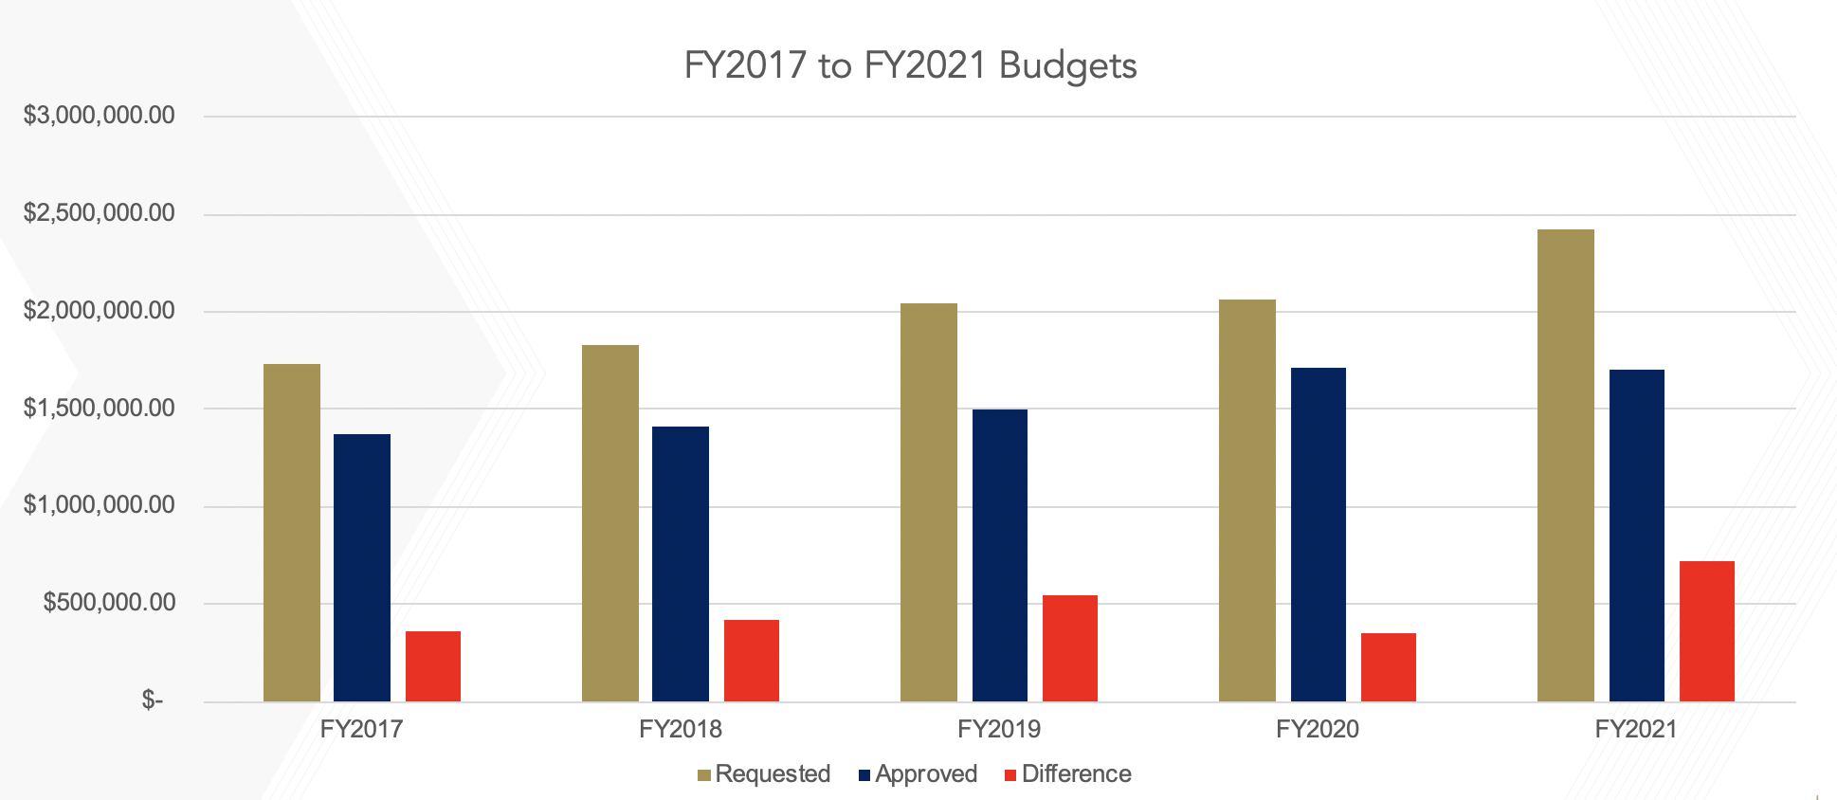
5 Year Trend
Refers to the Annual Budgeting Process - does not include the rolling bills

Slide 19
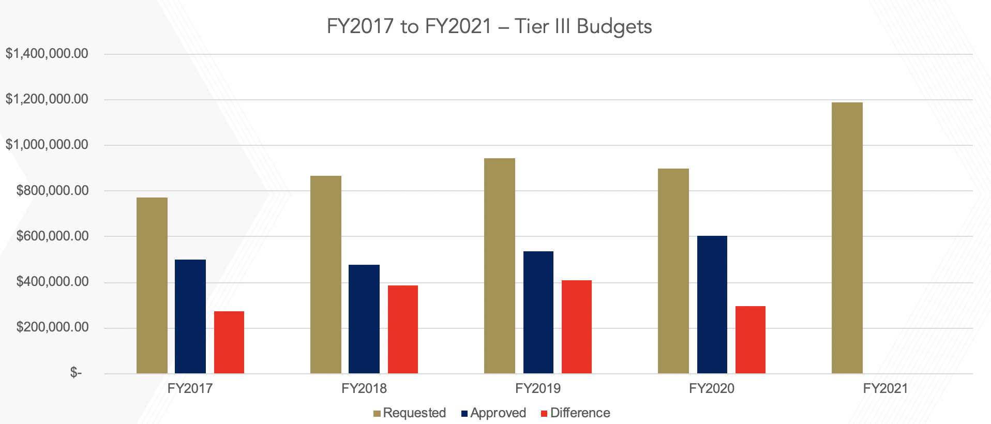
In the Future
Changes will be made to our funding policy to address current rate of allocations
All organizations will begin to face reductions in their overall funding from SGA
Tier III organizations will face the greatest impact from these funding reductions

Slide 20
Questions?

