Slide 1

Student Center
MSFAC November 7, 2019

Slide 2

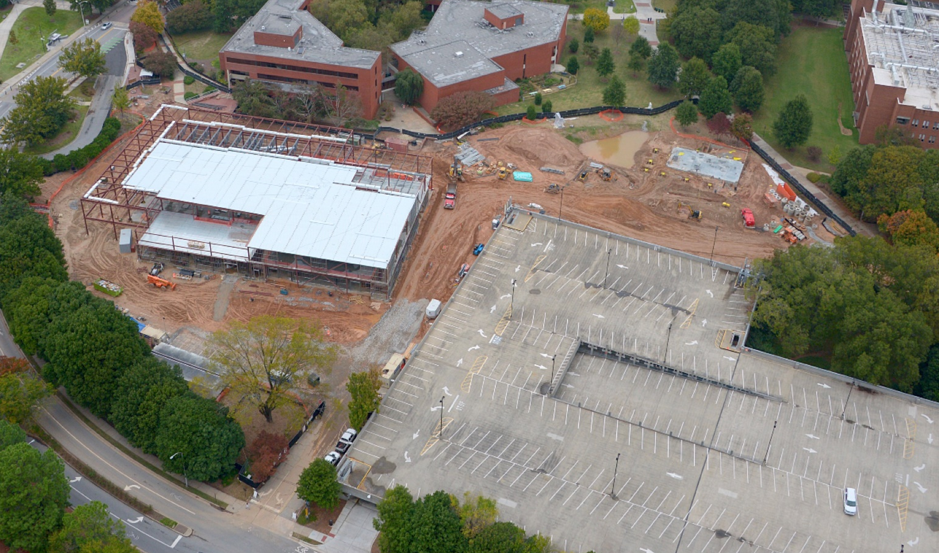
OVERVIEW
Snapshot of Student Center
Student Center Budget
  FY20
SC Operation Fee
  FY20
  FY 21
Campus Center Facility Fee
  FY21
Looking Ahead
  FY22
Notes:
Need image

Slide 3

Mission and Vision
Mission
The Mission of the Student Center is to build a strong sense of campus community by offering a wide variety of high-quality services, well-managed facilities, educationally relevant programs, and leisure-time activities that are second to none.
Vision
The Vision of the Student Center is to be the national leader in producing life-shaping campus experiences for students while providing an irresistible environment for the Georgia Tech community to gather.
Values
Bring Campus to Li³fe
Learning, integrity, inclusiveness, innovation, fiscal responsibly and exceptional service
Notes:
K

Slide 4
Snapshot of the Student Center
Over 17,000 people through the doors daily
The Student Center hosted 9,584 reservations in 2018
5,604 of the reservations are for Student Organizations
Peachtree was booked 527, ballroom 388, Theater 347 the theater
11,528 inquires at the information desk
Overall attendance at SCPC events 26,000 packages processed and delivered
110 Student Employees, 60 Full time staff and 109 student volunteers (SCPC)
Notes:
K

Slide 5

Student Center Budget – FY20
Funding Sources
S
C
P
C
Other Revenue
Operation Fee

Slide 6
Student Center Operation Fee – FY20
Personal Services
$1,348,224
  17 full time staff
  110 Student Employees
Non-Personal Services
$192,106
Supplies & Material
Maintenance & Repairs
Contracted Services
Telecommunications

Slide 7
Student Center Operations Fee – FY21
No Operation Fee Increase FY21
Last fee increase FY10
Mandatory Fee: $1,440,820
SGA Tier II: $169,189
Total Fees: $1,564,895
**This does not include the Campus Center Facility Fee**

Slide 8

Campus Center Facility Fee – FY21
$85 fee approved to start FY21.
$4,078,383 estimated be collected in FY21
Notes:
Aerial image of ph I

Slide 9
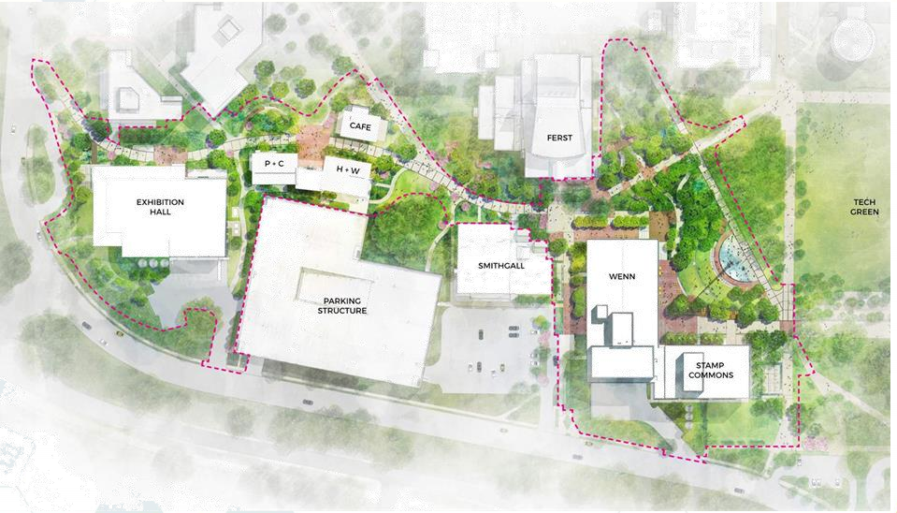
Looking ahead to FY22
Notes:
K

Slide 10
CONSTRUCTION TIMELINE
PHASE I
Summer 2019 –
Summer 2020
Exhibition Hall, Pavilions
PHASE II
Summer 2020 – Late 2022
Student Center, south addition
Transition to Phase II
May – July 2020
Move out of Student Center into temporary spaces
Notes:
K Phase 2

Slide 11
Looking Ahead to FY22
Student Center will be asking for $25 increase to the Operation Fee in FY22 to start in January 2022. This will make the fee $57 per semester.
Costs to be covered by the fee
  Personal
    Approx 70 student jobs
    Approx. 10 full time staff
Next steps
Continue to engage Student Center Advisory Board and SGA to discuss needed increase
Continue to work with GTHR to get organizational changes approved
Spring and Fall 2020 – work with students and SGA to share details of the needed positions.
Other ideas/thoughts/suggestions for communication before next fall?
Notes:
K Phase 2

Slide 12
Questions?
MSFAC November 7, 2019

