Slide 1
A cornerstone of Georgia Tech’s thriving, active community
CRC
Mandatory Fee Committee Presentation
Michael W. Edwards
Sr. Director Campus Recreation

Slide 2
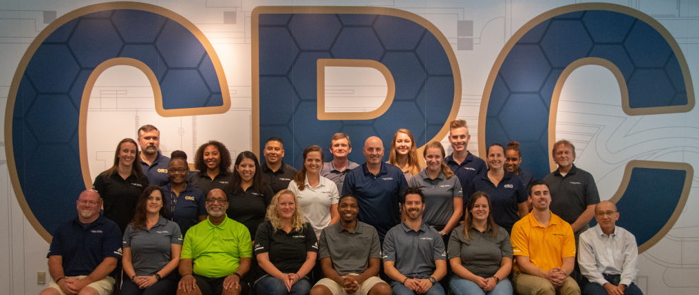
Presentation Outcomes
You should have a better understanding of…
Facility oversight
Programs, Services and Facilities
Provided
CRC Utilization/Satisfaction
Data, “By the Numbers”
Current and Future Improvements/ Partnerships
Funding and Budget
Fee Reduction Potential Impacts

Slide 3
Campus Recreation Vision/Mission
Vision
To be the leader in collegiate recreation by providing comprehensive and engaging programs and services that strengthen community well-being and enhance student success.
Mission
Campus Recreation champions health and well-being through
dynamic and transformative experiences.

Slide 4
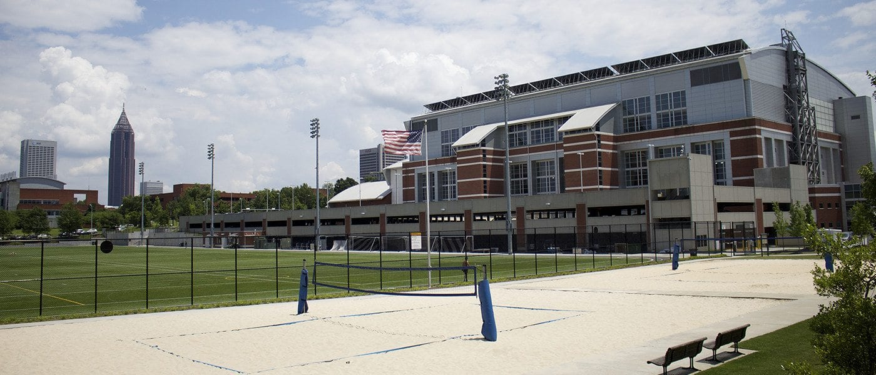
Facility Oversight
Campus Recreation Center
Roe Stamps Recreation Field
Alumni Park (Sand Volleyball)
Couch Park (Burger Bowl)
Leadership Challenge Course

Slide 5

Core Programs and services
Program/Operational Areas
  Aquatics
  Facilities/Operations
  Business Operations
    Finance Management
    Member Services
    Marketing
    Information Technology
  Healthy Lifestyle Programs
    Competitive Sports
      Intramurals
      Sport Clubs Clubs
    Fitness
    Outdoor Recreation (ORGT)

Slide 6
FY20…By the numbers
Open July 1, 2019 – March 20, 2020
Closed March 21, 2020 – August 9, 2020
2020 Customer Satisfaction 4.50 (+.02)
16,467 distinct student users (-7.8%)
  4,547 Graduate Students (-6%)
4440 participants in Intramurals (-7%)
1111 teams in Intramurals (+4%)
1556 unique participants in 41 Sport Clubs (-2.32%)
3457 participants in Outdoor Recreation activities (-19.5%)
2208 Participants in Fitness Programs (-22.2%)
4 Signature Campus Events
  Rec Fest, Halloween 5k, Pi Day 5k, Customer Appreciation Week
Social Media
  Facebook – 11,281 (+1.2%)
  Instagram – 3,001 (+9,8%)
68,090 pieces of equipment checked out (-26.4%)

Slide 7
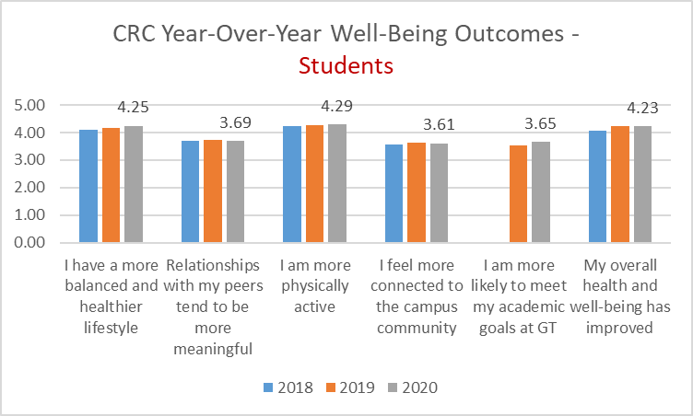
Participant Experience - Assessment

Slide 8
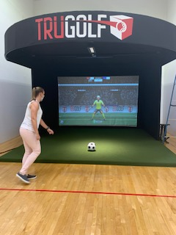
CRC Upgrades/replacement/improvements
Current Improvements
Dead Lift Zone Increased Platforms (+2)
New Line of Machines (ADA compliant)
New Sport Simulator (Golf, Soccer, Hockey, Baseball, Dodgeball, Disc Golf, Bowling, Foot Golf)
New Bench Press/Squat Rack Reservation System
New Sound System on Video Board

Slide 9
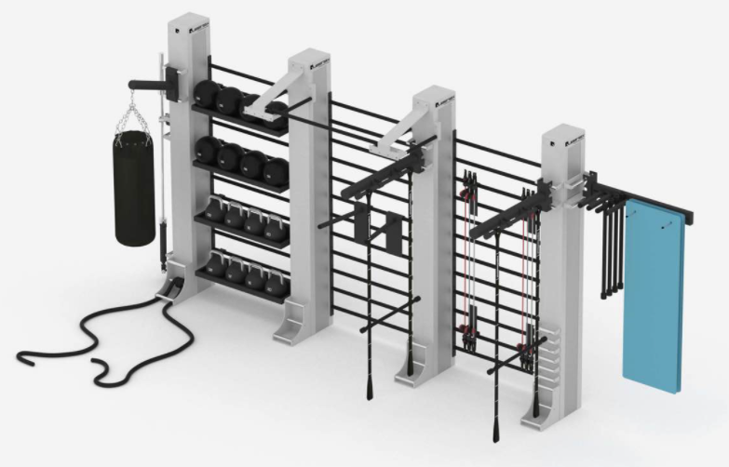
CRC Upgrades/replacement/improvements
Delayed Projects/Equipment
New Cycle Room (including virtual programing)
New Functional Training/Fitness Room
Fifth Floor Track Equipment Replacement
Fitness Floor Dumbbell and Rack Replacement

Slide 10

CRC Funding sources
Mandatory Fee
SGA Tier II (ORGT)
Revenue
Resident Instruction
Additional Sources

Slide 11
FY20 Budget
FY20 Operating Budget
Mandatory Fee $1,867,470
SGA (ORGT) $ 136,345
Revenue $1,755,015
Resident Instruction $ 452,518
Additional Institute Support $ 1,845,642

Slide 12
FY20 overall operational costs

Slide 13
Use versus costs FY20

Slide 14
FY21 Budget/Covid-19 impact Budget
FY21 Budget
Revenue
Mandatory Fee $2,356,375
Debt Service Fee $2,546,258
Generated Revenue $2,231,696
RI $403,108
ORGT $84,593
Expense
Personnel Services $3,191,813
OSE $1,738,181
Travel $145,778
Debt Service $2,546,258
FY21 Budget Covid-19 Impact
Revenue
Mandatory Fee $2,326,870
Debt Service Fee $2,514,559
Generated Revenue $796,680
RI $392,942
ORGT $84,593
Expense
Personnel Services $2,703,991
OSE $1,208,343
Travel $29,156
Debt Service $2,514,559
0,90
Projected Loss $340,405

Slide 15
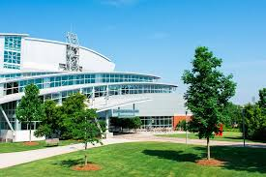
FY22 OPERATIONAL Budget Request
Mandatory Fee $2,347,833
SGA Tier III (ORGT) $ 84,593
Total Fees $2,432,426
Revenue $1,557,584
Resident Instruction $392,942

Slide 16
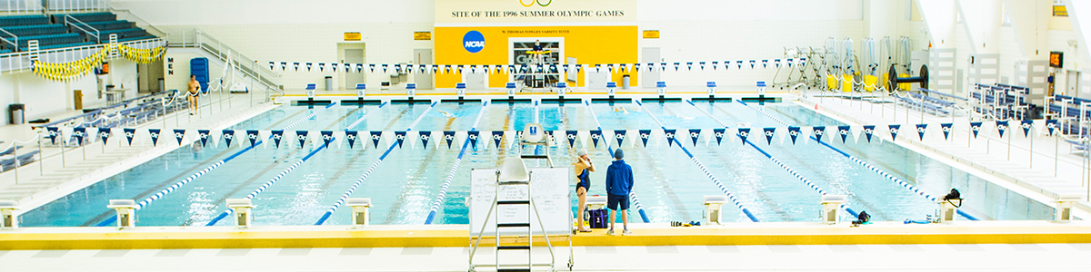
$5 reduction in mandatory fee
Personnel Services $163,404.00
Non Personnel Services $ 87,174.00
$250,577.00

Slide 17
CRC hours impact
Current Planned Hours
Monday-Thursday 5:30 a.m. to 12 a.m.
Friday 5:30 a.m. to 10:00 p.m.
Saturday 9:00 a.m. to 10:00 p.m.
Sunday 12:00 p.m. to 12:00 a.m.
115 hours of operation
Adjusted Hours
Monday – Friday 6:00 a.m. to 2:00 p.m., 4:00 p.m. to 10:00 p.m.
Saturday – 9:00 a.m. to 1:30 p.m. , 3:30 p.m. to 8 p.m.
Sunday – 12:00 p.m. to 8:00 p.m.
87.5 hours of operation

Slide 18
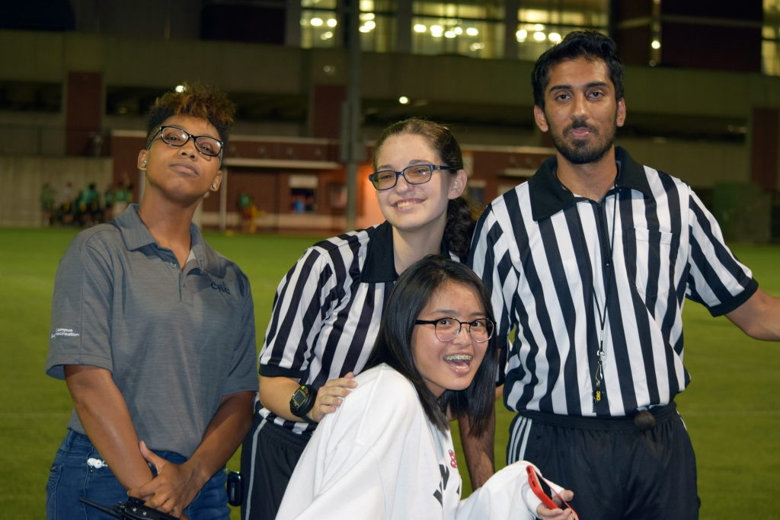
Fee Reduction impact
Intramural Registration
Increase Team Registration = $17
Current Team Entry Fee $50 - $65
Increased Team Entry Fee $67 - $82
Delay
Upgrades/Replacement/Improvements
Events
Potential Revenue Loss $275K – 350K
Current long-term obligations
US Open 2021,22,23,24
US Junior Nationals 2021,22,23,24
NCAA Div. I Swimming & Dive 2022,26

Slide 19
Challenges for the future
The impacts of a potential $5 fee reduction
Building revenue generating back to pre covid-19 levels
Retain professional talent with the lack of advancement opportunities, competitive salaries and work loads.
Meeting the demands of an increasing student population.
Maintain McCauley Aquatic Center at a level that continues our competitiveness in the market place.
The need to secure additional funding sources to maintain programs and services
Upkeep of a facility that is aging and meeting the demands of new technology and regulations.

Slide 20
Thank you

